Slide 1
Case 8: Customer Feedback System

Slide 2
Agenda
Introduction
Building confidence
Engaging the audience
Visual aids
Final tips & takeaways

Slide 3

The power of feedback Survey
Notes:
Feedback is one of the most powerful influences on learning and achieve- ment, but this impact can be either positive or negative. Its power is fre- quently mentioned in articles about learning and teaching, but surprisingly few recent studies have systematically investigated its meaning.

Slide 4

advantages
The feedback survey is a medium that allows companies to gather measurable insights so that the feedback data can be used to develop newer and effective business strategies, build new relationships, retain loyalty, and scale growth.

Slide 5
Engaging the audience
Make eye contact with your audience to create a sense of intimacy and involvement
Weave relatable stories into your presentation using narratives that make your message memorable and impactful
Encourage questions and provide thoughtful responses to enhance audience participation
Use live polls or surveys to gather audience opinions, promoting engagement and making sure the audience feel involved
Notes:
Survey should encourage users to do survey and give feedback to imrprove

Slide 6
Effective System
Why are feedback surveys important? Surveys help you gather real-time data and make strategic decisions.
It helps you uncover opportunities for improvement, validate business decisions, and understand how you can boost business growth.
Impact feedback is the most effective type of feedback to start with because it informs a person about the results of their behavior without dissecting the details, assuming motivation, or placing blame.
Notes:
Impact feedback is the most effective type of feedback to start with because it informs a person about the results of their behavior without dissecting the details, assuming motivation, or placing blame.

Slide 7
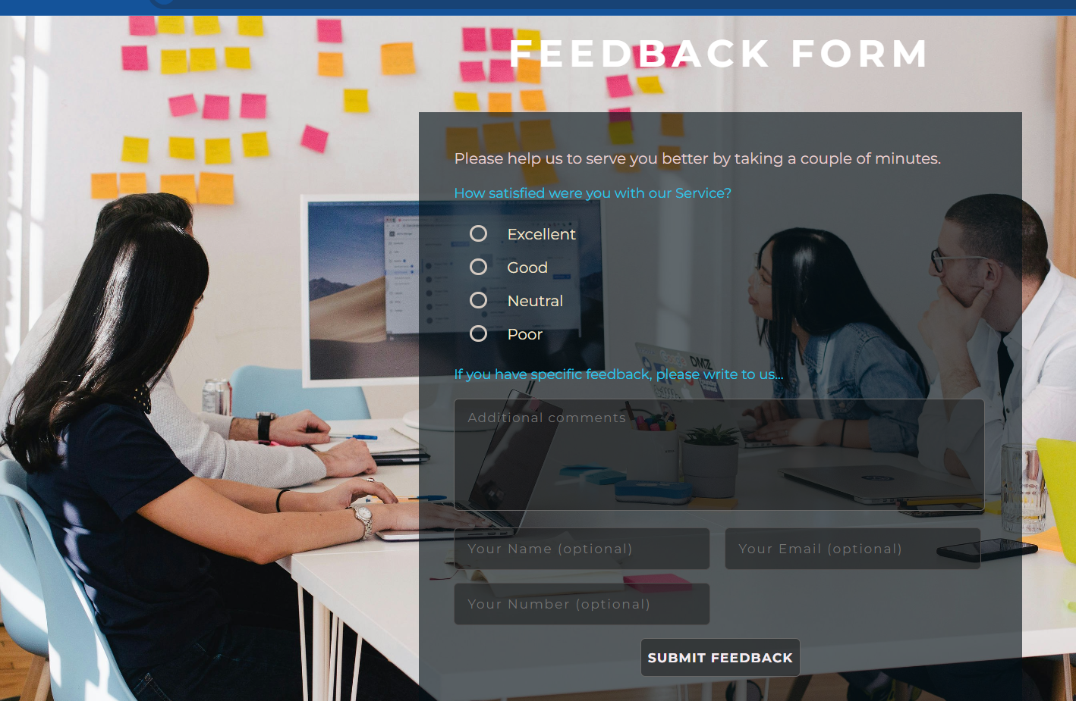
Home Screen
Notes:
Home screen of page that allows the user to give rating. Users can also give personal information

Slide 8

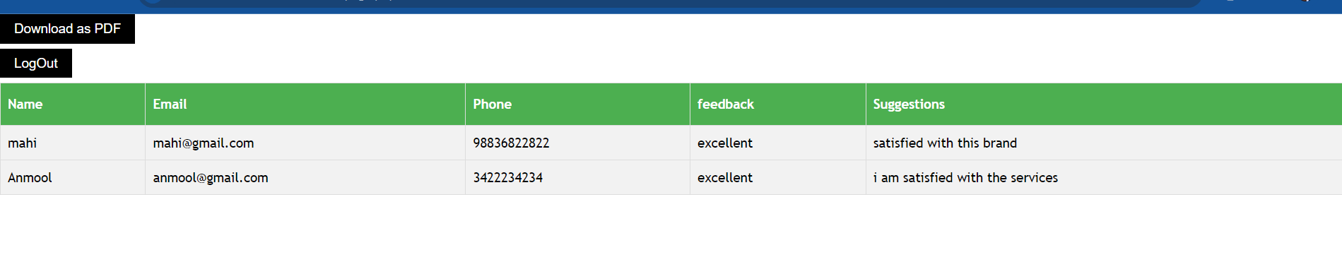
Impact on Admin side​

Slide 9
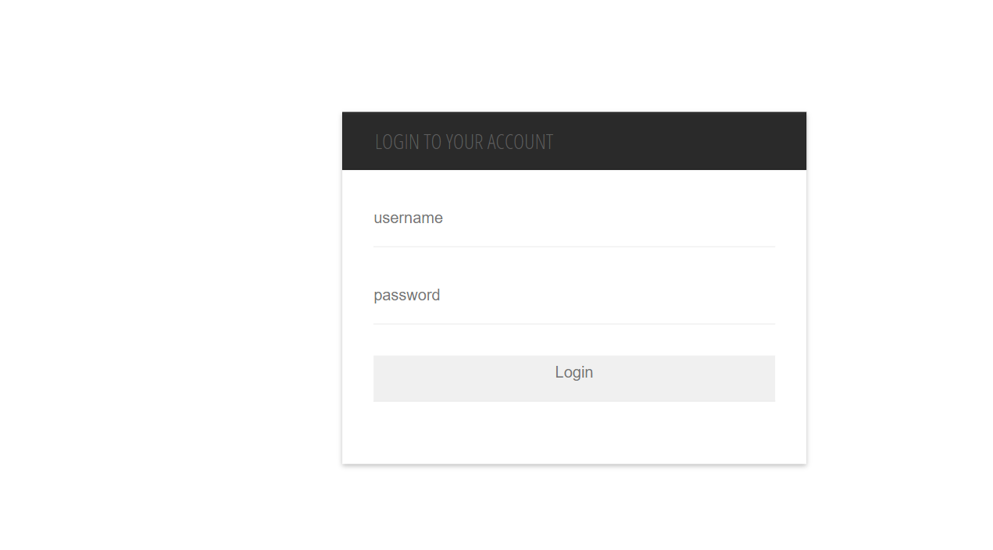
Admin login page
Notes:
Admin can login to see the user feedback that are submitting from users.

Slide 10
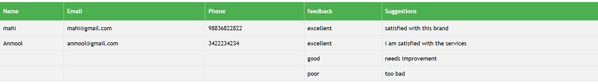
Db data
Notes:
Db data in admin panel

Slide 11
THANK YOU

